Slide 1
Zomato Market Insights
Boosting Performance In depth.

Slide 2

Overview of Zomato
Optimizing Key Insights .
Improving Customer Experience to Boost in Business Making Decision.

Slide 3

Insights : Average Rating (3.17)
Indication of on an average of 3.17 ratings indicates balanced.

Slide 4

Recommendation: Improving Average Rating (3.17)
Target low-rating restaurants
Customer engagement surveys.

Slide 5


Insights: Sum of Votes (1.15 Million)
Customer Engagement over 1 Million creating a great ecosystem that could lead to take business decision with ease.

Slide 6

Recommendation: Encouraging Voting
Top reviewer & Gold membership campaign.
Data-driven promotions

Slide 7


Insights: Count of Restaurants (6,000)
Upsurge in overall Growth & Demands Competitive for the smaller and new restaurants.

Slide 8

Recommendation: New Establishments
Expand into under-served markets for small and new restaurants.
Diversify offerings Innovative.

Slide 9
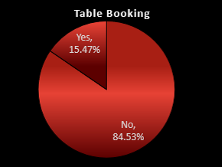

Insights: Table Booking (Yes - 15.47%, No - 84.53%)
84.53% of Zomato users do not use the table booking feature, preferring walk-ins, while only 15.47% opt to book in advance.

Slide 10

Recommendation: Exclusive Elite Experience
Incentivize table bookings & Elite booking features to drag customer attention and experience.

Slide 11
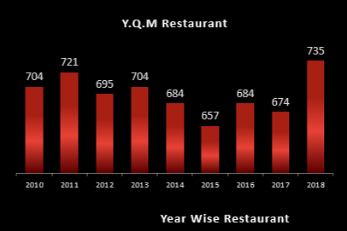
Insights: Year-Wise Restaurant Growth
In 2014-2016 from saturation & competitive market challenging to rise in the year 2018 marked with new heights fighting against other platforms.

Slide 12

Recommendation: Restaurant Onboarding & Small Businesses
To keep the momentum grow Quarterly, Yearly we must focus on new restaurants across regions & cities.
Targeting small business with ease of getting onboarding with promotion.

Slide 13
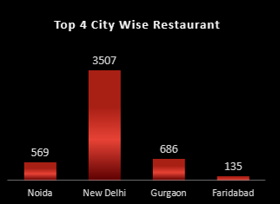
Insights: Top 4 City-Wise Restaurant Distribution
Why New Delhi itself Dominates other cities with a number stands out 3507 ? What are the things to be sorted out to carry further those numbers with Tier 2 & Tier 3?

Slide 14
Recommendation: Focus on other Tier Cities with Promotions
Advantages of expansion on markets with campaign to capture new markets in Tier 2 & Tier 3 Cities.
Creating city-specific promotion to attract customers to engage.

Slide 15
Insights: Year-Wise Restaurant Data
The platform experienced a peak growth in restaurant additions in 2018, with 735 new restaurants, following a consistent upward trend after 2013.
The slight slowdown between 2014-2016 could be a result of increased competition or a plateau in demand.

Slide 16
Recommendation: Target Extension & Restaurant Retention
Maintaining the restaurant addition pace by targeting cities.
Retension strategies to the existing restaurants enhancing value–added service and perks.

Slide 17
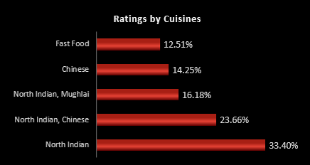
Insights: Ratings by Cuisines
There is a temptation on North Indian Cuisines that beats other segments cuisines while running in urban area.

Slide 18
Recommendation: Promoting Cuisine Specific Offers
Campaigns or offer on other cuisines should be promoting within North Indian restaurants to enhance the engagement along with Culinary Expansion on targeting less popular cuisines as “ Experience a New Taste “.

Slide 19
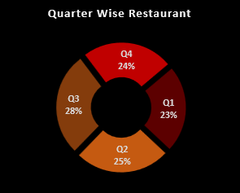
Insights :Quarter-Wise Restaurant Performance
Q2 and Q3 have the highest restaurant activity, accounting for 28% and 25% of the total restaurants added. This suggests these quarters align with peak times for restaurant openings, possibly linked to seasonal factors like holidays.

Slide 20
Recommendation: Push in Seasonal Market
Seasonal Marketing Push: Align marketing and promotional efforts during Q2 and Q3 to encourage new restaurant sign-ups and customer engagement.
Balanced Promotion Throughout the Year: Spread incentives for restaurant sign-ups across quarters to ensure steady growth throughout the year.

Slide 21
Conclusion:
Customer Ratings: Focus on improving average ratings through customer feedback loops and quality control.
Restaurant Growth: Encourage restaurant expansion in underrepresented cities and regions.
Table Bookings: Boost table booking adoption with exclusive rewards and offers.
Cuisine-Specific Campaigns: Leverage the popularity of North Indian cuisine for promotions while expanding awareness of other cuisines.

